Slide 1
LLMs for Conversational Geodata Search
Faculty of Environmental Sciences
Chair of Geoinformatics
AGILE 2025 Tutorial, Dresden, Germany
Auriol Degbelo, Simeon Wetzel, Stephan Maes
Notes:
Important concepts
Agent (a bit of history)
LLM Agents
Tools
Workflows
Memory
Reflection
Multi-Agent Architectures
Agent-based modelling: https://www.nature.com/articles/s41598-023-35536-3
https://www.ncbi.nlm.nih.gov/books/NBK305917/

Slide 2
Agenda
Search Targets
GeoQuery
Retrieval-Augmented Generation

Slide 3
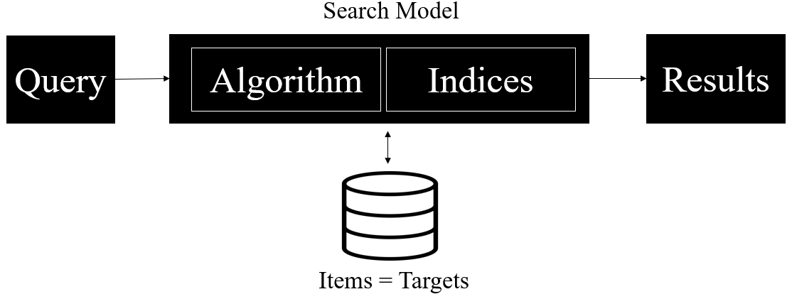
Automated Information Retrieval
Key abstract components

Slide 4

What are QA Systems?
“Question Answering (QA) Systems can be considered as an extension of Search Engines in the sense, that they aim at automatically supplying users with precise answers to questions posed in natural language, instead of simply returning a ranked list of relevant sources based on a set of keywords”. (Dimitrakis et al, 2020)
Where is Dresden located?
Where is Dresden located?
Q&A
System
Old Search Engines
Dresden is located in Germany
Notes:
https://www.flaticon.com/free-icon/search-bar_3815525?term=result+list&related_id=3815525&origin=search

Slide 5
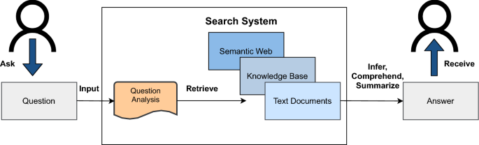
Question Answering Systems
Key abstract components
[Zaib et al, 2022]

Slide 6
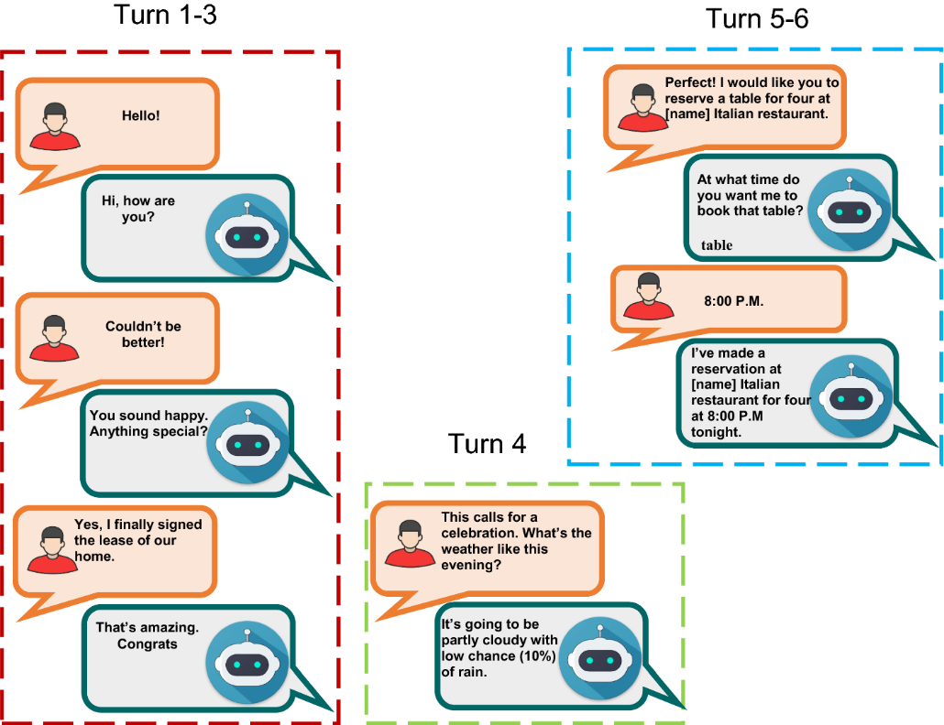
Conversational Question Answering Systems
Key abstract components
History Modelling
+
Chat-Oriented
Task-Oriented
[Zaib et al, 2022]
Notes:
Chatbots are systems that can carry on extended conversations with the goal of mimicking the unstructured conversations or ‘chats’ characteristic of informal human-human interaction.
Task-oriented dialogue systems converse with users to accomplish fixed tasks like controlling appliances or finding restaurants, relying on a data structure
frame called the frame, which represents the knowledge a system needs to acquire from chatbot the user (like the time to set an alarm clock).

Slide 7
Search Targets, GeoQueries

Slide 8
Search Target
A search target is a resource searched for.
Georeferenced datasets
Georeferenced videos
Raster maps
Interactive maps
Geospatial services (e.g. OGC web services)
Shapefiles
Algorithms in scientific papers
…
Geographic Information Retrieval: Text
Multimedia Information Retrieval: Audio, Video, …
Dataset Search: Dataset
…

Slide 9
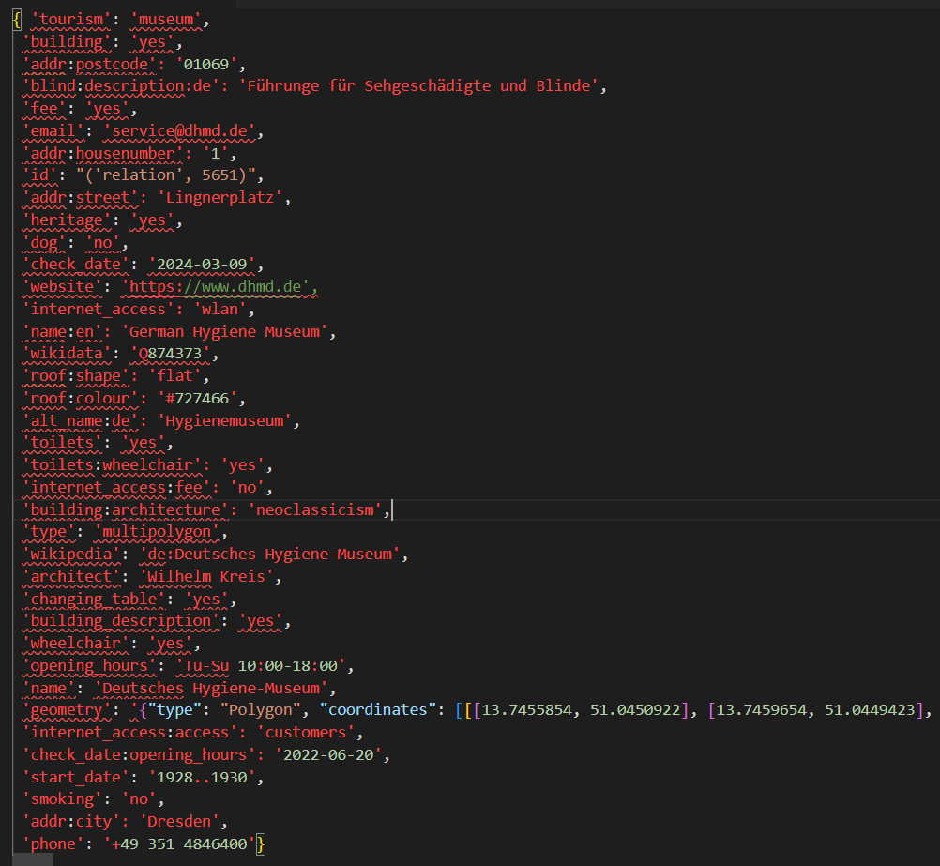
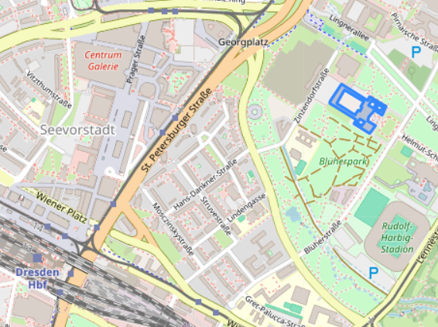
Search target for our scenario: document
metadata
document = id + metadata
Example:
id: ('relation', 5651)
Visualization

Slide 10


GeoQuery
Need vs Query
A clear statement in natural language that describes what the user is asking for or wants to know.
‘I am looking for restaurants near Dresden'.
Need
expresses
Query
The expression of the user information need in the input language provided by the information system.
[Baeza-Yates and Ribeiro-Neto, 1999]
Q1: „restaurant near Dresden“
restaurant
Q2: SELECT r where ….
Q3
within/near
Dresden

Slide 11
GeoQuery
Definition
Geoquery = A query that requests location-specific information
= The expression of the user’s need for location-specific information
in the input language provided by the information system

Slide 12
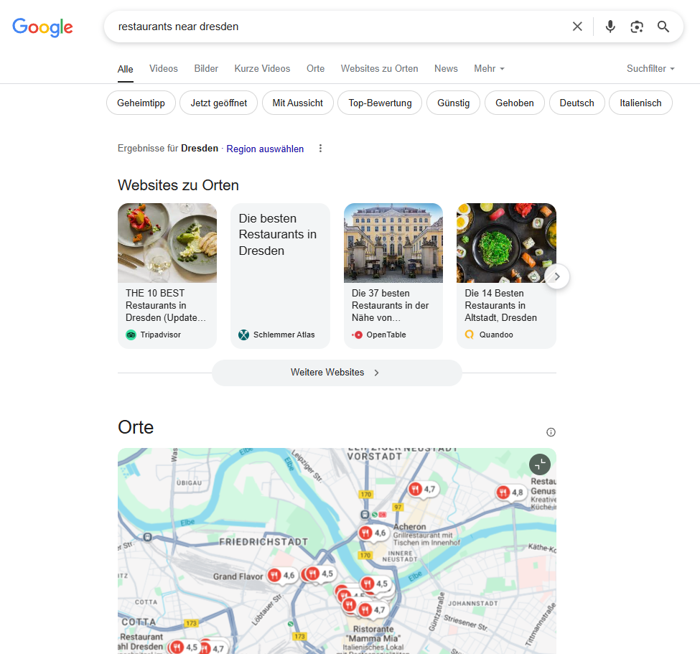
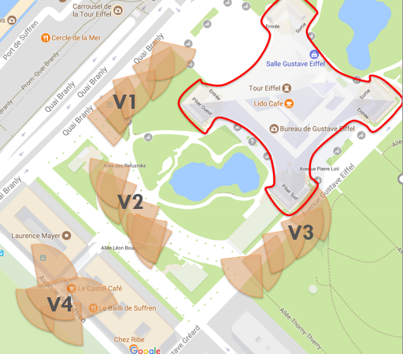
GeoQuery
Two forms of geoqueries
<theme><relationship><space> [Purves et al, 2018]
(very often <object><relationship><place> [Carniel, 2023])
Weather in Dresden
Restaurants near Dresden
Castles inside Dresden
Houses north of Dresden
<resources> about <theme><space><time> [Degbelo, 2022]
Maps about the cities of Prussia in 1830
Videos about the Eiffel Tower in 2020, whose spatial locations are within bbox

Slide 13
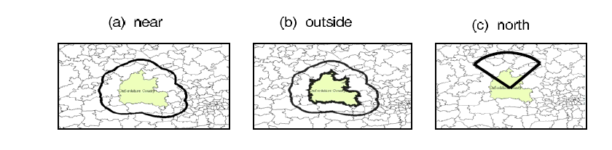
GeoQuery Interpretation
A geoquery has a footprint
The footprint of a spatial term P-footprint indicates the geographical location of the intended place, and is specified in terms of map coordinates with a selected reference system. [Fu et al, 2005]
A query footprint Q-footprint defines a geographical space that covers the intended spatial search extent of the query, and it is specified in the form of map coordinates. [Fu et al, 2005]
Castles rel Oxfordshire
[Fu et al, 2005]

Slide 14
Retrieval-Augmented Generation

Slide 15
Retrieval-Augmented Generation
“RAG is a technique for augmenting LLM knowledge with additional data.
LLMs can reason about wide-ranging topics, but their knowledge is limited to the public data up to a specific point in time that they were trained on. If you want to build AI applications that can reason about private data or data introduced after a model's cutoff date, you need to augment the knowledge of the model with the specific information it needs. The process of bringing the appropriate information and inserting it into the model prompt is known as Retrieval Augmented Generation (RAG)”. [source]
RAG = LLMs + Your Own Data [CSV, JSON, Webpages, PDF, Graph Data, … ]
GeoRAG = LLMs + Your Own Data + Spatially-Explicit Reranking

Slide 16
Retrieval-Augmented Generation
A RAG Application typically needs three steps…
Indexing (dividing targets into smaller chunks and storing these, usually before the user query)
Retrieval (selection of relevant chunks to the user query)
Generation (answer formulation based on the chunks from the previous step)

Slide 17
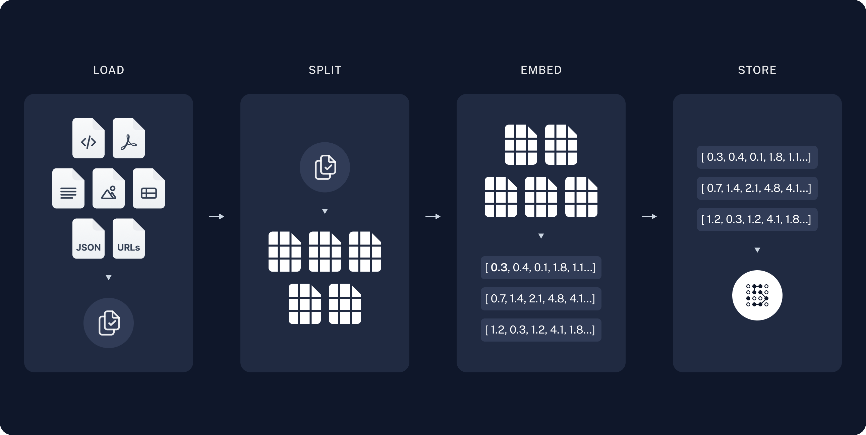
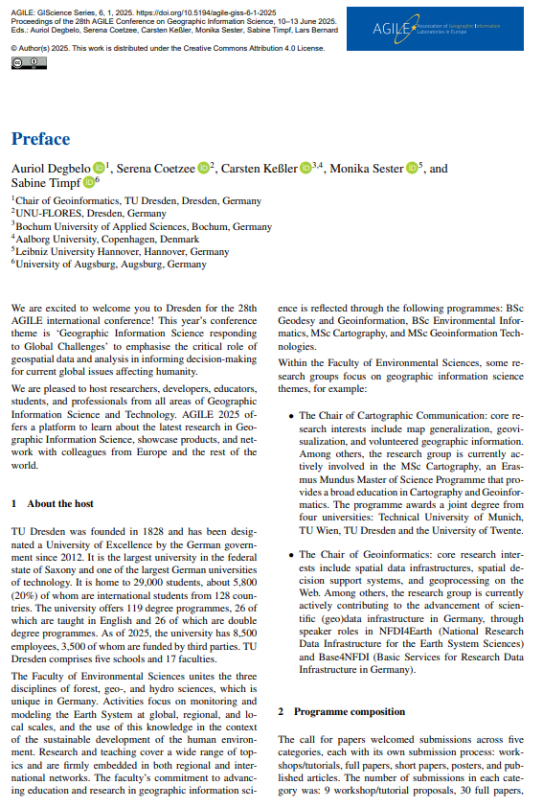
RAG: Indexing and Storage
https://python.langchain.com/docs/tutorials/rag/

Slide 18
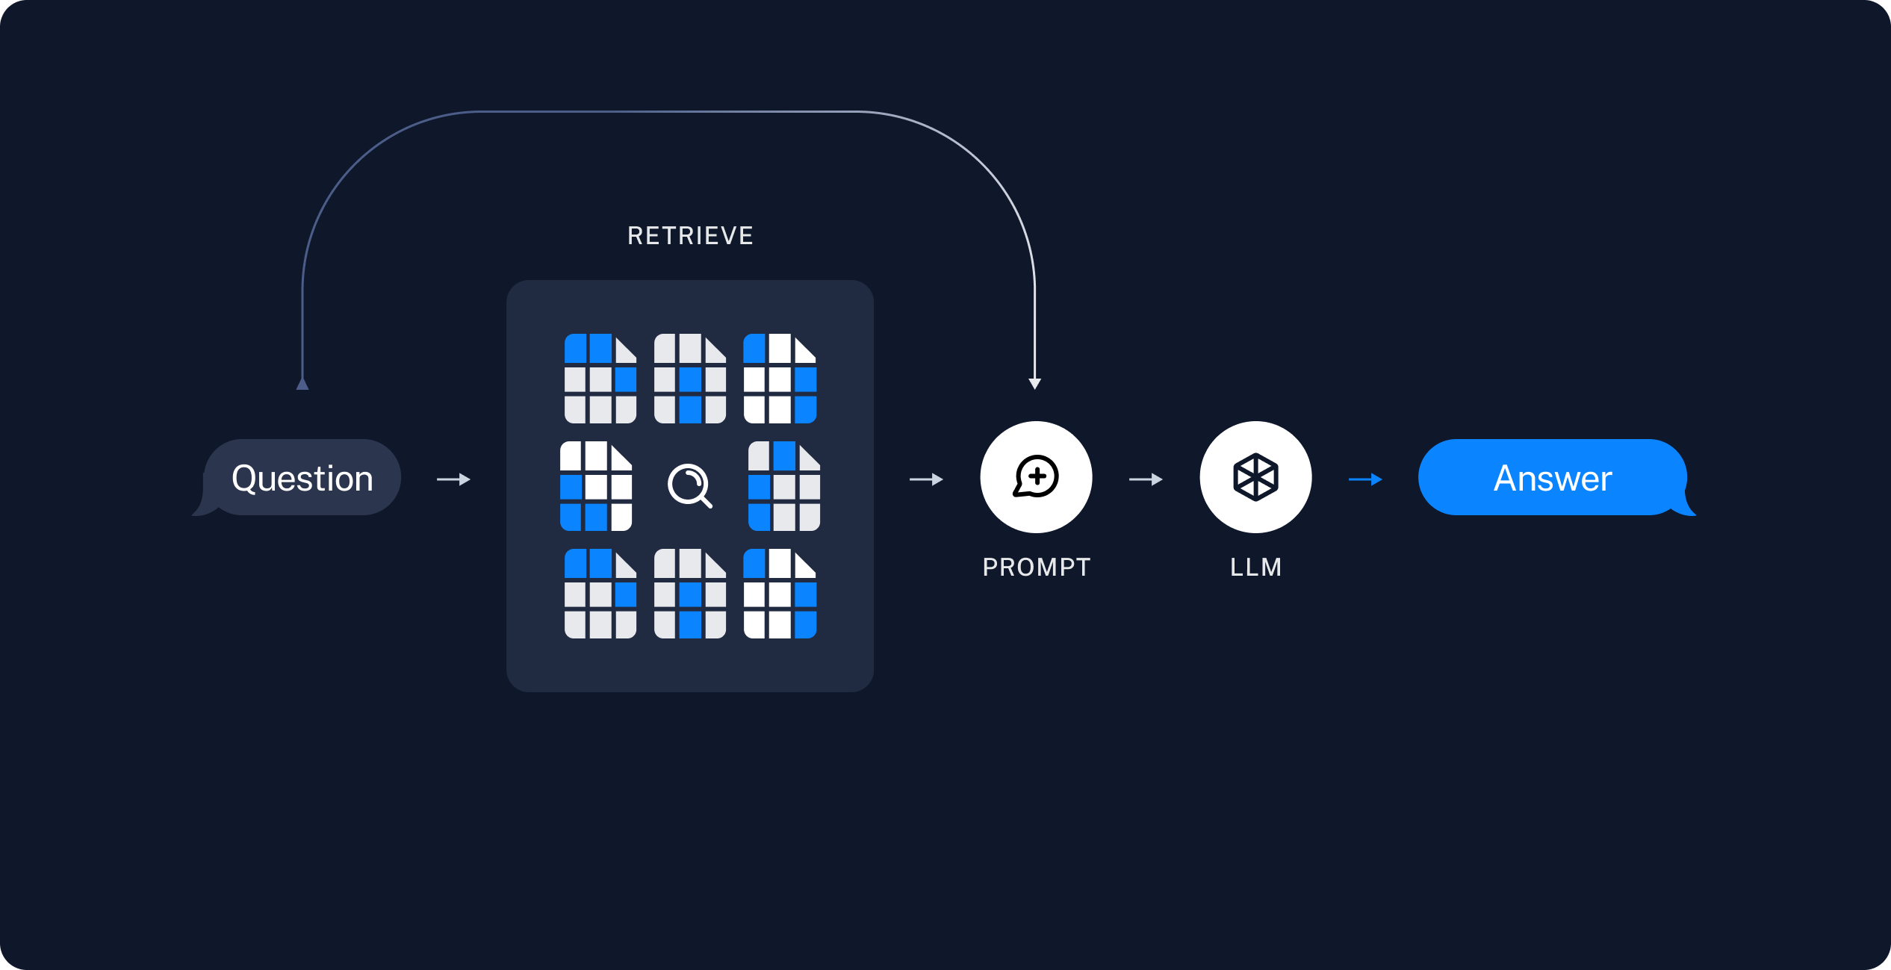
RAG: Retrieval and Generation
Q: “Who are the authors of this document?”
A: “The authors are…”
https://python.langchain.com/docs/tutorials/rag/

Slide 19
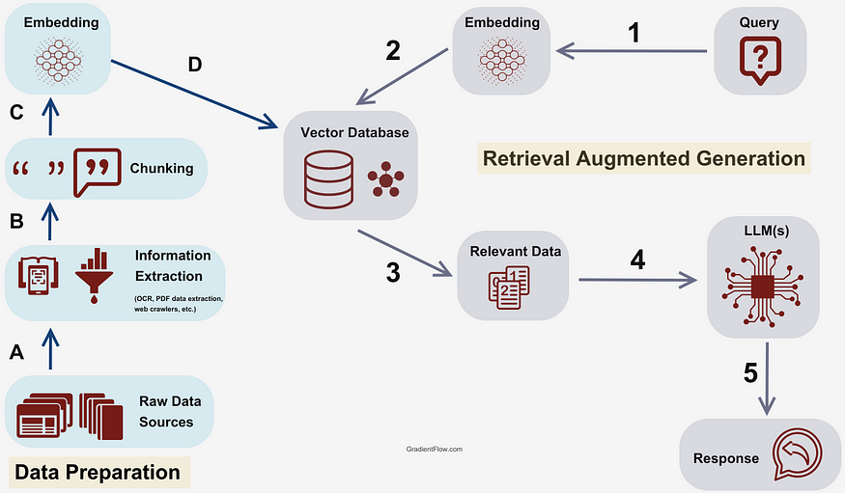
RAG: All steps at once
https://aswin19031997.medium.com/enhancing-conversational-ai-with-retrieval-augmented-generation-rag-leveraging-csv-integration-3000322819eb

Slide 20
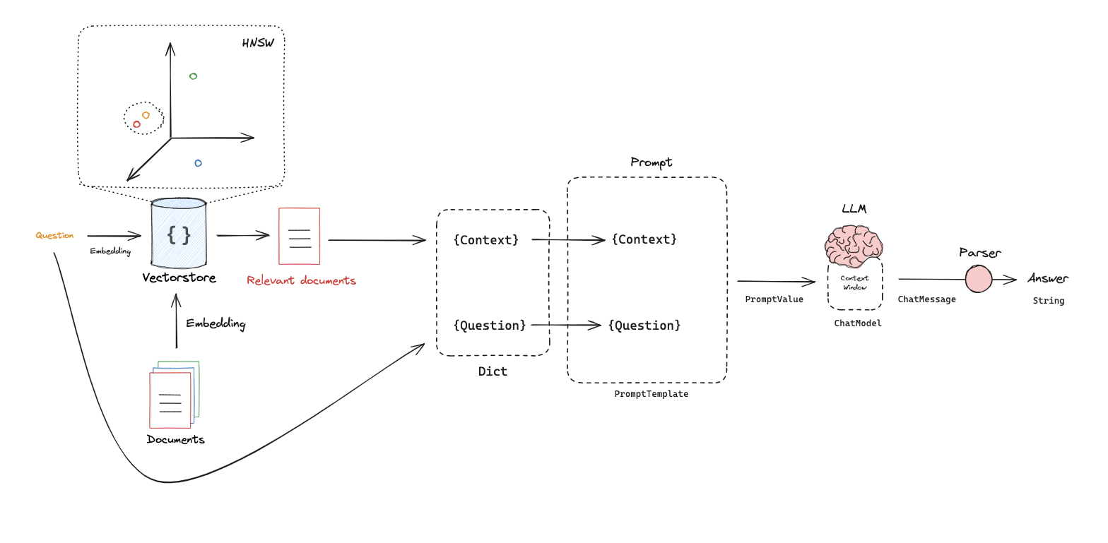
Examples of RAG Architectures
Basic RAG Architecture
Embedding Model
Vector Store
PromptTemplate
Chat Model
Parser
2
1
5
4
3
Notes:
It is less architecture in the classical sense, but rather key components of the overall workflow

Slide 21
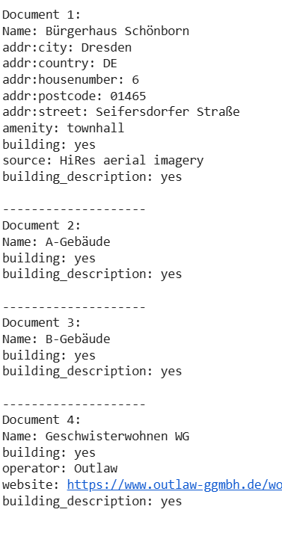
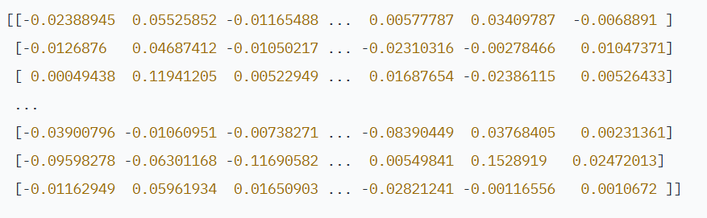
Our scenario: from search target to embedding
all metadata
selected metadata
embedding
document = id + metadata
Example:
Text-based metadata only
“An embedding is a numerical representation of a piece of information, for example, text, documents, images, audio” [source]
Additional examples
Notes:
results = collection_buildings_with_names.query(query_texts=["Hygiene museum"], n_results=1) print(results.get('documents')[0][0])

Slide 22
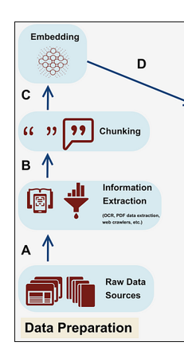
Embedding model for vector creation
from chromadb.utils.embedding_functions import SentenceTransformerEmbeddingFunction
model_name = "paraphrase-multilingual-mpnet-base-v2"
ef = SentenceTransformerEmbeddingFunction(model_name=model_name)
Notes:
results = collection_buildings_with_names.query(query_texts=["Hygiene museum"], n_results=1) print(results.get('documents')[0][0])

Slide 23
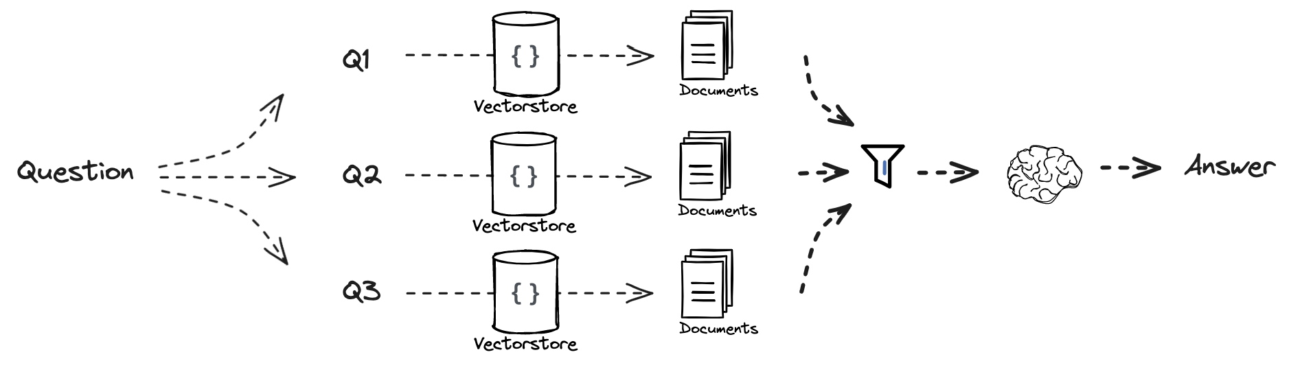
Examples of RAG Architectures
Expansion: RAG Fusion
https://github.com/langchain-ai/rag-from-scratch/blob/main/rag_from_scratch_5_to_9.ipynb
Notes:
Intuition: generate multiple queries to improve recall

Slide 24
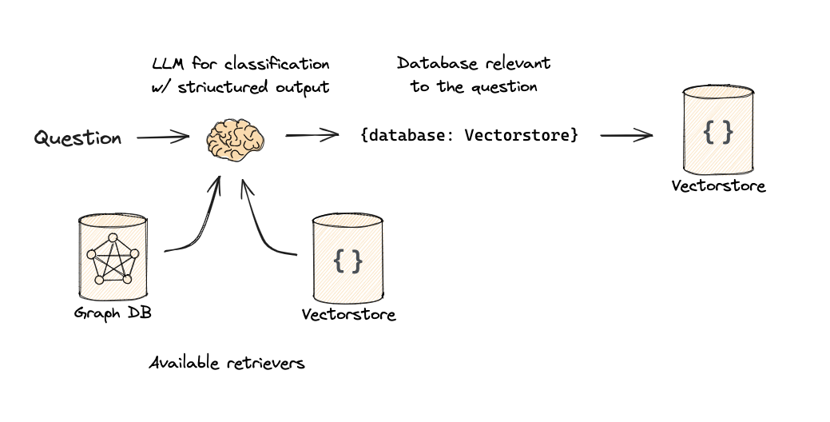
Examples of RAG Architectures
Logical Routing: Let LLM choose DB based on the question
https://github.com/langchain-ai/rag-from-scratch/blob/main/rag_from_scratch_10_and_11.ipynb

Slide 25
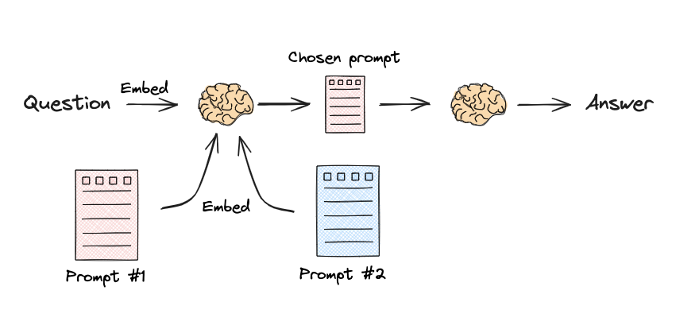
Examples of RAG Architectures
Semantic Routing: Embed question and choose prompt based on similarity
https://github.com/langchain-ai/rag-from-scratch/blob/main/rag_from_scratch_10_and_11.ipynb

Slide 26
References
Baeza-Yates, R. and Ribeiro-Neto, B. (1999) Modern information retrieval. New York, New York, USA: ACM Press.
Carniel, A.C. (2023) ‘Defining and designing spatial queries: the role of spatial relationships’, Geo-spatial Information Science, pp. 1–25. Available at: https://doi.org/10.1080/10095020.2022.2163924.
Degbelo, A. (2022) ‘FAIR geovisualizations: definitions, challenges, and the road ahead’, International Journal of Geographical Information Science, 36(6), pp. 1059–1099. Available at: https://doi.org/10.1080/13658816.2021.1983579.
Dimitrakis, E., Sgontzos, K. and Tzitzikas, Y. (2020) ‘A survey on question answering systems over linked data and documents’, Journal of Intelligent Information Systems, 55(2), pp. 233–259. Available at: https://doi.org/10.1007/s10844-019-00584-7.
Fu, G., Jones, C.B. and Abdelmoty, A.I. (2005) ‘Ontology-based spatial query expansion in information retrieval’, in R. Meersman, Z. Tari, M.-S. Hacid, J. Mylopoulos, B. Pernici, Ö. Babaoglu, H.-A. Jacobsen, J.P. Loyall, M. Kifer, and S. Spaccapietra (eds) On the Move to Meaningful Internet Systems 2005. Springer, pp. 1466–1482. Available at: https://doi.org/10.1007/11575801_33.
Purves, R.S., Clough, P., Jones, C.B., Hall, M.H. and Murdock, V. (2018) ‘Geographic information retrieval: progress and challenges in spatial search of text’, Foundations and Trends® in Information Retrieval, 12(2–3), pp. 164–318. Available at: https://doi.org/10.1561/1500000034.
Zaib, M., Zhang, W.E., Sheng, Q.Z., Mahmood, A. and Zhang, Y. (2022) ‘Conversational question answering: a survey’, Knowledge and Information Systems, 64(12), pp. 3151–3195. Available at: https://doi.org/10.1007/s10115-022-01744-y.

